Slide 1
Statistics + Economics = Econometrics
Fintech society
Oliver De Fusco

Slide 2
Data
Age | Wage
21 | $21,000
When we make an observation and record the result, that is data.
E.g. We may write down someone’s age and at the same time we record a person’s wage – We have now observed and recorded two points of information/data (Data point). Repeating this more than once is a Data set.
Econometrics is the study of financial and economic data like age and wages using statistical methods. We aim to uncover the relationship between variables for prediction or understanding.

Slide 3
Pandas
To do statistics we need to manipulate data
Pandas is a free open source python library which lets us easily manipulate data.
The use of Panda’s is based around a DataFrame object which stores data for us. It has in-built functions allowing us to easily manipulate the data without re-inventing the wheel for every project.
A DataFrame is made of an index (custom, position, dates/times) and a series, which stores the data.
A DataFrame is like an excel sheet while a series can be an excel column. We just think in terms of columns instead of single points.

Slide 4
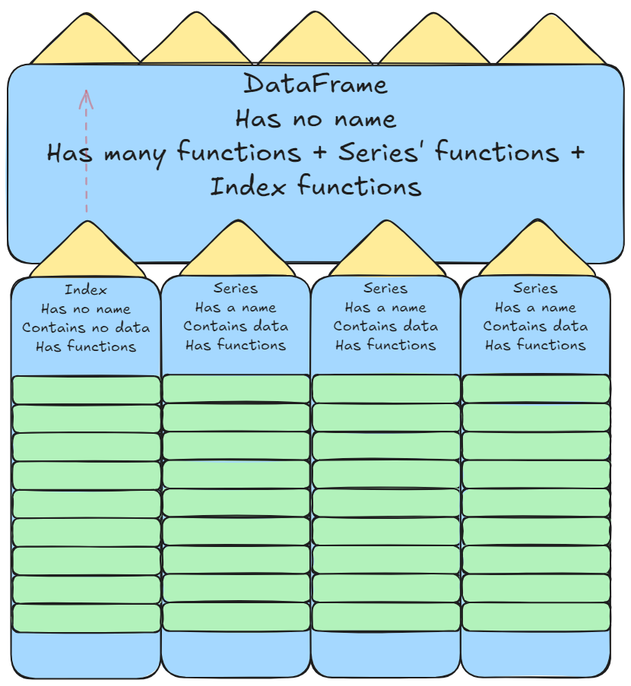
We will normally assign a DataFrame to a variable in python to be referenced later, this is not to be confused with it having a name.

Slide 5
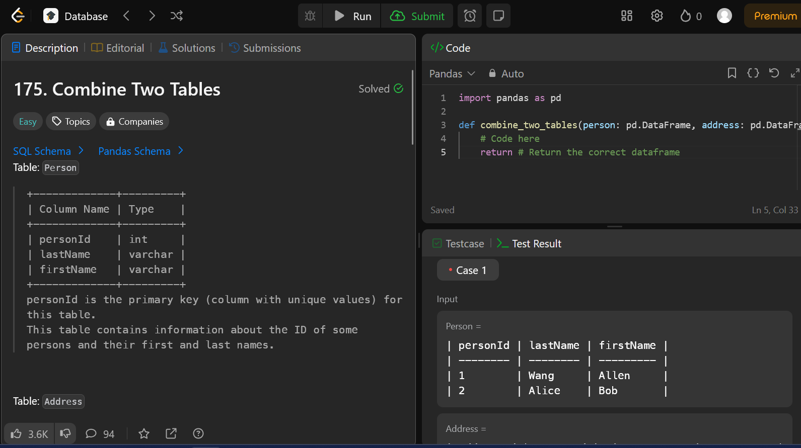
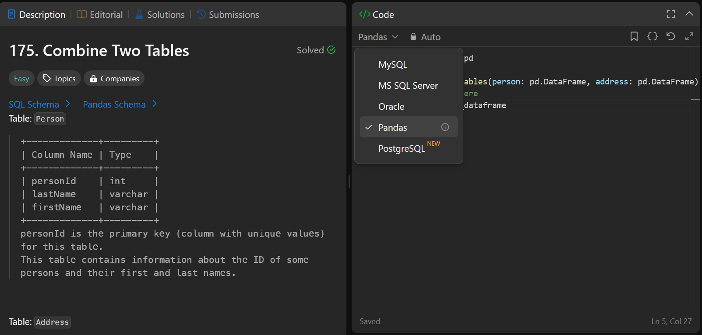
Practice
Pandas documentation: https://pandas.pydata.org/docs/reference/index.html
https://leetcode.com/problem-list/database/?difficulty=EASY
By filtering Leetcode problems labelled by Data base you can get questions for pandas. They are not timed and they even give you solutions but you wont learn if you just copy. I encourage using the pandas documentation and googling.
Pressing Run will test your solution against test cases provided, submitting will add your attempt to your submissions list.
For database questions you need to select Pandas (AKA python) as your coding language.
After pressing Run the function failed to return the correct data frame.
As a result “Case 1” is red and returned an error showing the differences between yours and the correct answer.

Slide 6
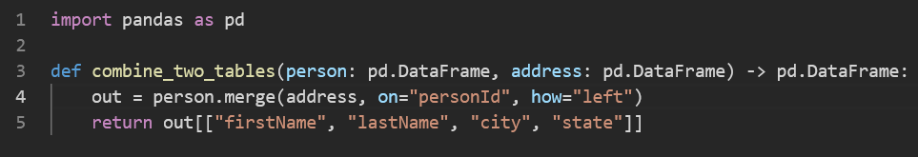
Solution for combine two tables
Solution to previous question is to use the .merge function

